Slide 1
Exploration of Food and Nutrition Data Using Python
An Analytical Approach to Nutritional Insights

Slide 2
Business Scenario Overview
Why It’s Important:
The rise in lifestyle diseases like obesity and diabetes increases the need for accurate nutritional data.
Consumers are increasingly aware of the nutritional value of their food choices.
Companies in the food industry require insights to create healthier food options and stay competitive.
Application in the Real World:
Nutritional analysis enables informed decision-making for consumers and food developers.
Supports the development of public health policies based on data-driven food trends.
Assists healthcare providers in offering personalized dietary recommendations.

Slide 3
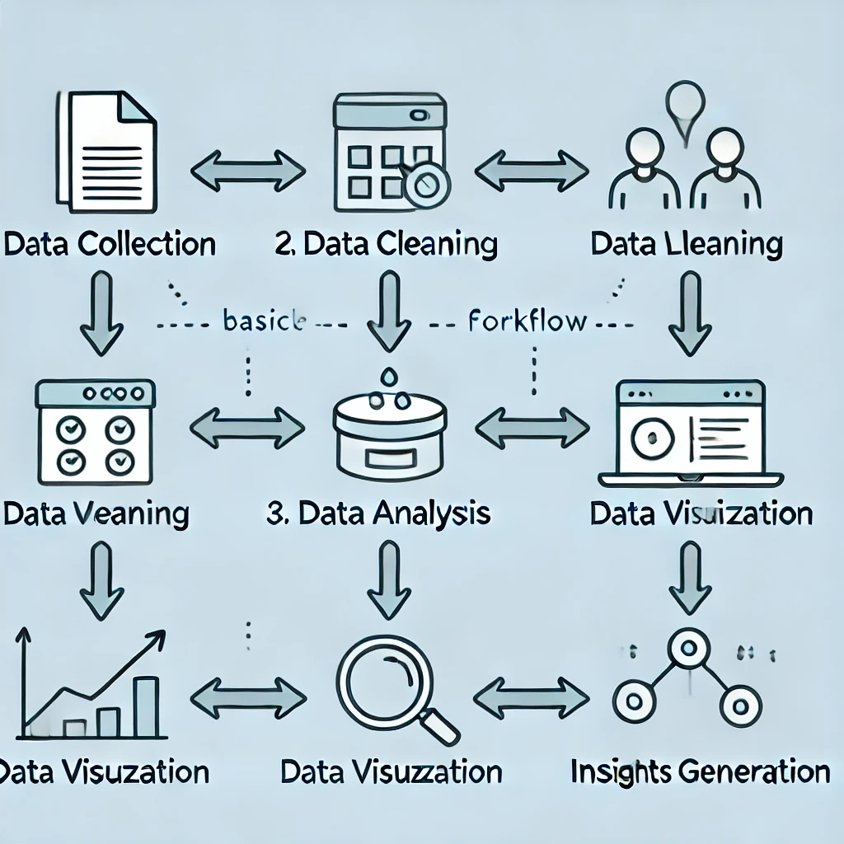
Work Flow

Slide 4
Data Overview
Dataset Key Columns:
Food: Name of the food item.
Measure: Serving size.
Grams: Amount in grams.
Calories, Protein, Fat, Fiber, Carbs: Nutritional values.
Category: Food category (e.g., Dairy, Vegetables).
Initial cleaning involved replacing erroneous values, converting data types, and handling nulls.

Slide 5
Data Cleaning
Replaced 't', 't'' with 0 for negligible values.
Removed characters and commas for numeric calculations.
Converted columns (Grams, Calories, Protein, etc.) to numeric types.
Dropped rows with NaN values for a clean dataset.

Slide 6
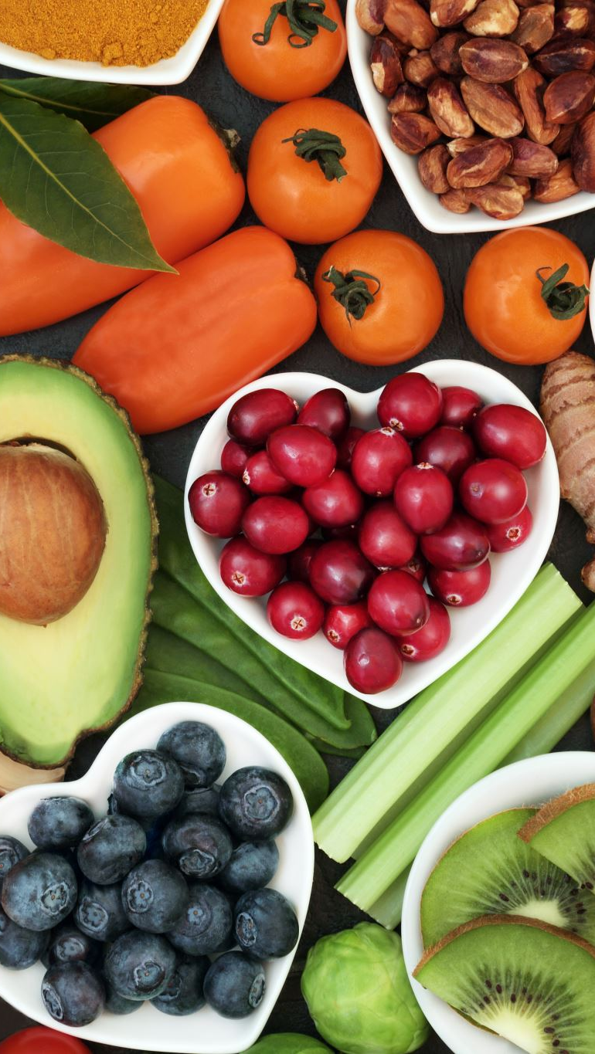
Exploratory Data Analysis (EDA)
Protein Rich Foods:
Bar chart of top 20 protein rich foods (e.g., Vegetables, Grains, Seeds).
Caloric Content:
Highlighted foods with the highest calorie content.
Fat Content:
Visualized top 20 high fat foods with bar charts.

Slide 7
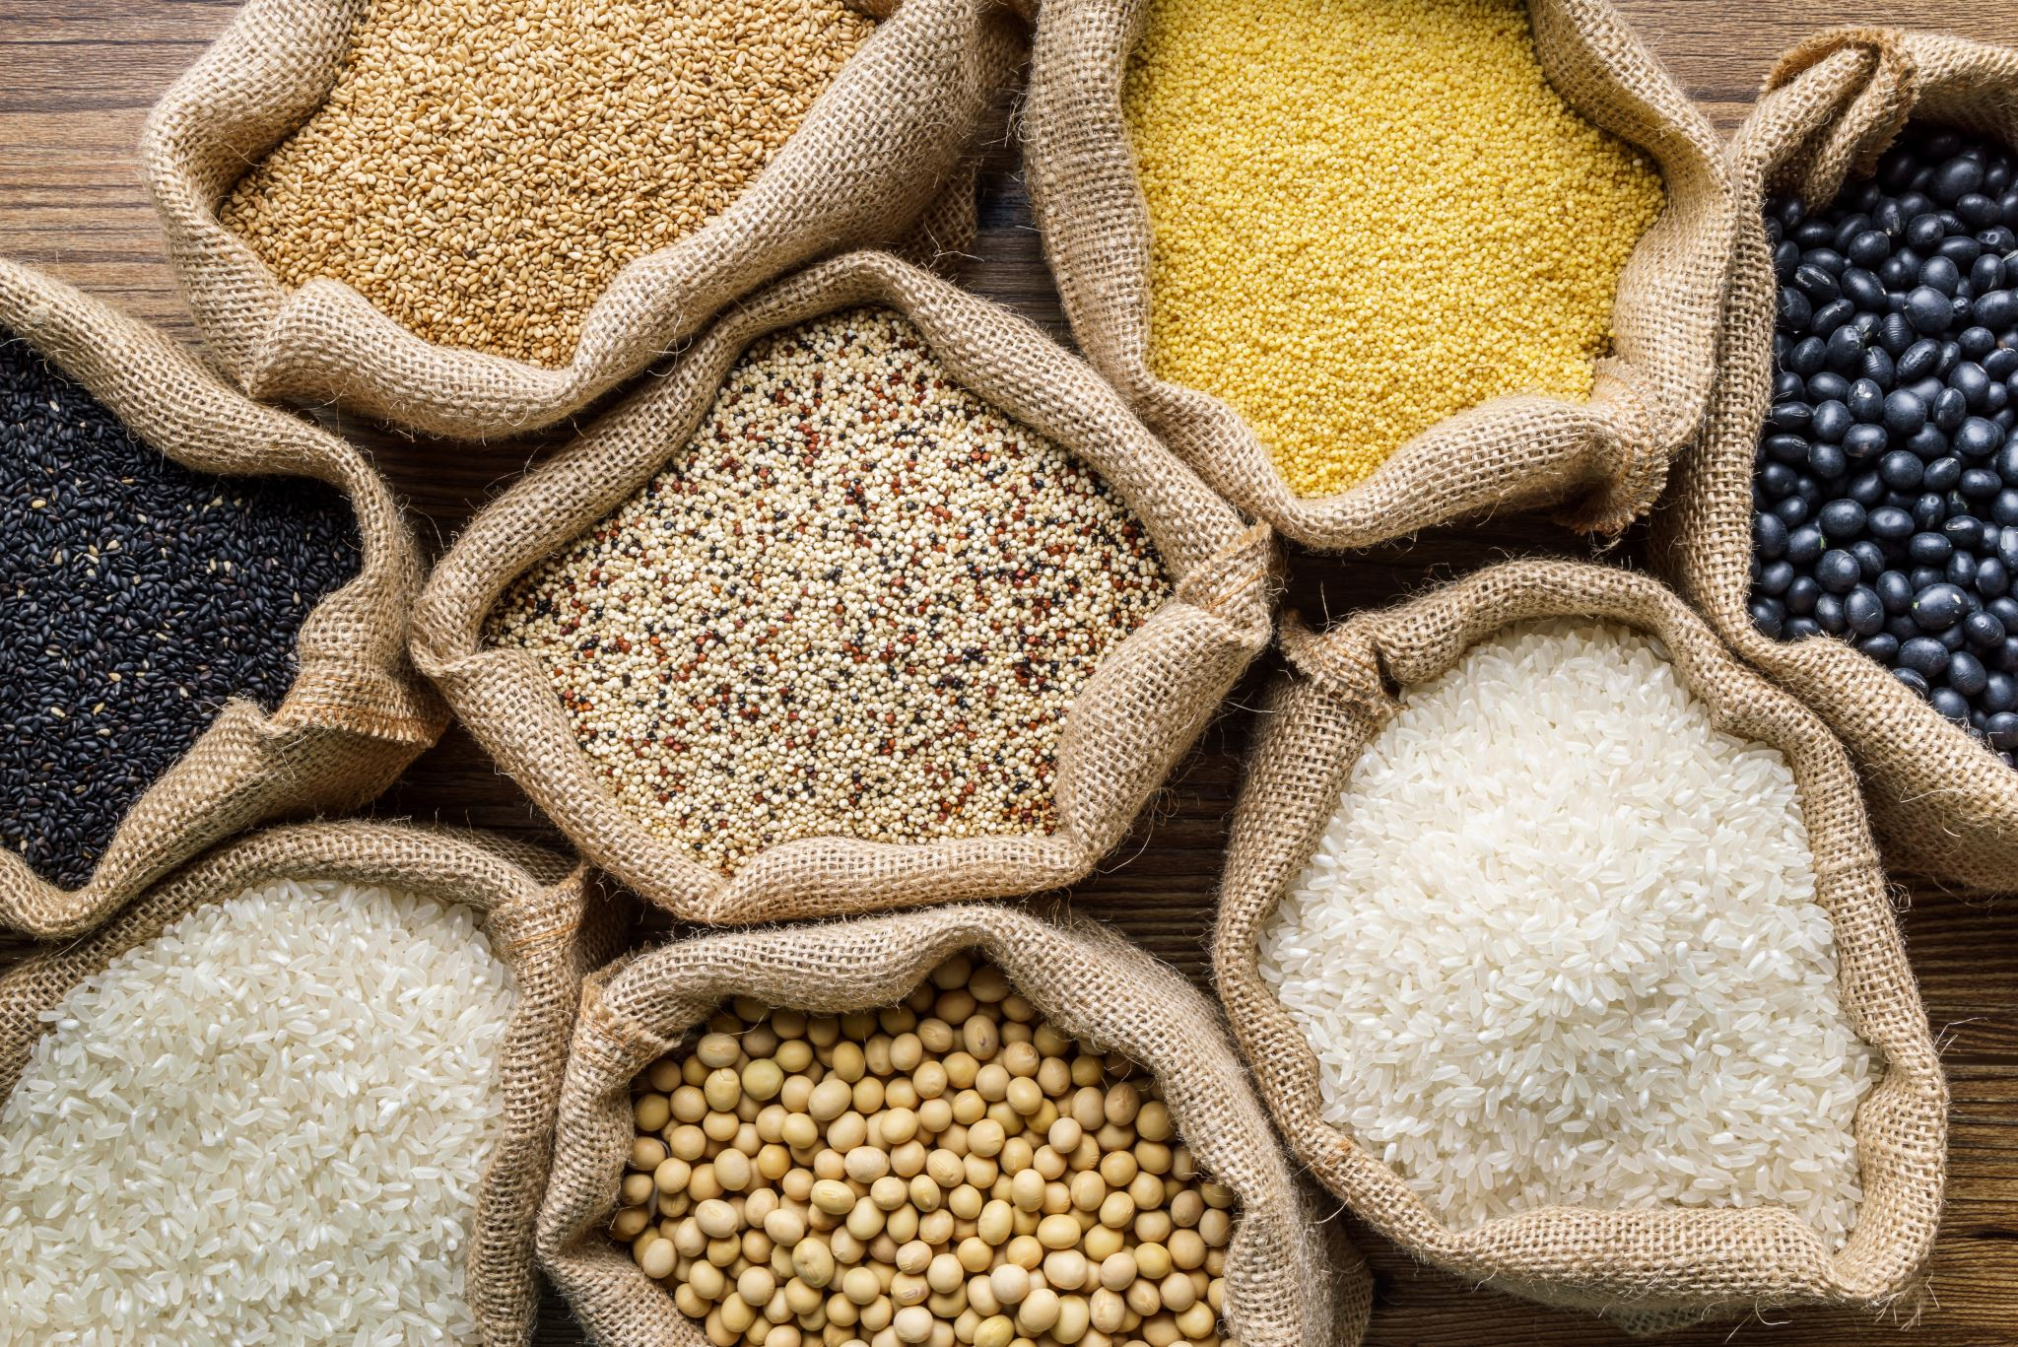

Category Analysis
Grouped data by food category to analyze nutritional distribution:
Pie charts of total calories, fat, protein, fiber, and carbs per category.
Largest contributors:
Breads, cereals: High in calories and carbs.
Seafood: High in protein.

Slide 8
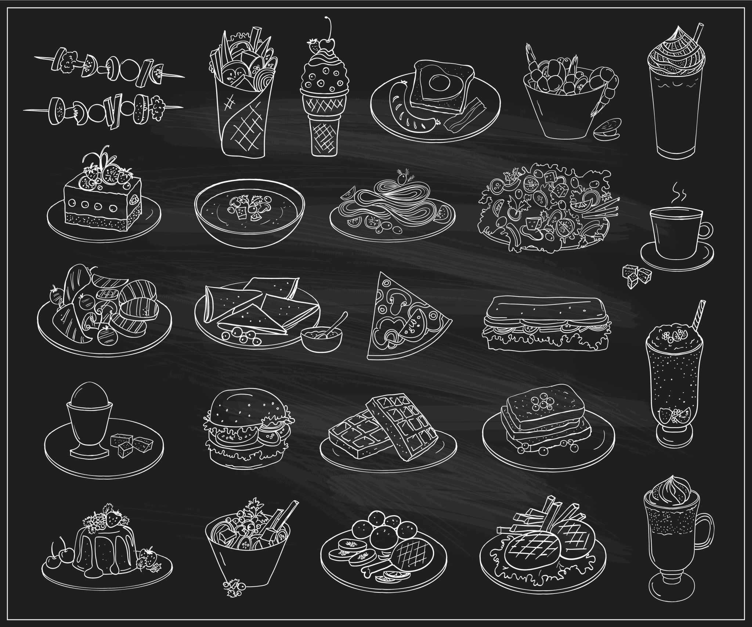
Specific Food Categories
Desserts and Drinks:
Funnel charts for high calories desserts.
Meat and Seafood:
Pie chart for protein rich meats.
Scatter plot for top 10 fattest meats and seafood.

Slide 9
3D Scatter Plots
Visualized relationships between variables using 3D scatter plots:
Fat content across categories and food items.
Interactive markers to show nutritional insights.

Slide 10
Insights and Challenges from the Project
Key Insights:
Nutritional trends vary significantly across food categories.
High-protein foods are concentrated in seafood and meats, while breads dominate in carbs.
Visualizations like pie charts and bar charts make complex data more comprehensible.
Challenges Faced:
Cleaning and handling inconsistent data entries.
Balancing detail with simplicity in visualizations for better audience understanding.

Slide 11
Conclusions
Key Findings:
High Protein Foods: Seafood like oysters and flatfish.
High Calorie Foods: Fortified milk, white bread.
High Fat Foods: Oysters, butter.
Breads, cereals: Largest contributors to carbs and calories.
Seafood: Major source of protein.

Slide 12
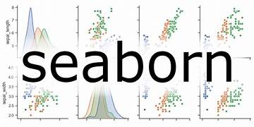


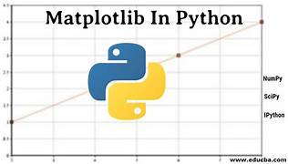
Tools Used

Slide 13

THANK YOU

